Slide 1

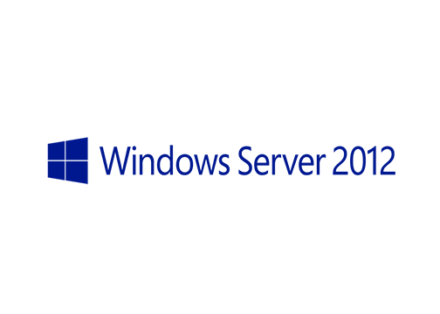
MegaSeries
Introduction to Hyper-V

Slide 2
Intro
Not a New feature in Windows Server 2012 but can be considered a reborn feature
One of the most important additions to this OS version and the base for Hyper-V implementations in future Windows Server operating systems

Slide 3
Some new additions
Powershell support
VM replication
Memory improvements
Shared nothing live migration
New VHDX hard disk format
Resource metering
…and many more

Slide 4
Dynamic memory
In 2012 the memory allocations has been improved
Memory on a VM can be static (always consumes the amount specified) or dynamic (has a minimum and a maximum value and consumes as much or little memory it needs that fits in this limit)
There are 3 memory settings when dynamic memory is used:
Startup memory: Is used at machine startup when usually it needs more memory than it may need in a Idle state
Minimum memory: The minimum amount of memory that this machine can get from the host (usually when in Idle)
Maximum memory: The maximum amount of memory that can be allocated

Slide 5
Primary virtual disk types
Fixed disk: when creating the disk all space is allocated on the host storage
Dynamic disk: The disk only uses the amount of space that is needs and it grows to the maximum value as files are placed on it
Disk types can be converted using the GUI or Powershell

Slide 6
Networking – Hyper-V virtual switch
This is a virtual network device that you can use to connect VMs to networks
There are 3 types:
External: The switch is linked to one of the host’s network adapters and all VMs connected to the switch can access the outside network through the host’s NIC
Internal: The switch connects the host with the VMs connected to this switch but the VMs cannot go outside through the host’s NICs
Private: Machines connected to this switch can only communicate with one another but not with the host

Slide 7
Windows Server editions
Standard: The license you buy for the host also offers you 2 licenses for virtual machines
Datacenter: The license you buy with the host gives you unlimited licenses for virtual machines
Hyper-V Server: No licenses included but also the product is free to use

Slide 8
https://www.youtube.com/channel/UCcZ-jLbPwNr8E_v9-65n8Iw https://github.com/itknowledge4

